Slide 1
PCORnet®:
An Introduction
PCORnet® has been developed with funding from the Patient-Centered Outcomes Research Institute® (PCORI®)

Slide 2
Unite data and communities for faster, more targeted research
Providers and researchers
EHRs, claims, and patient-reported data
One PCORnet®, Many Possibilities
-----------------------------------------------------------
PCORnet is a national resource, funded by
PCORI, where high quality health data, patient partnership, and research expertise deliver fast, trustworthy answers that advance health outcomes.
Real-world evidence studies
Comparative effectiveness research
Population health research
Pragmatic research
Health systems research
And more
More Than a Data Network
-----------------------------------------------------------
Access to patient partners and thousands
of clinicians with expert knowledge of
PCORnet-enabled data = meaningful research targets and faster answers.
Patients, caregivers, and advocates
2

Slide 3
Data Insights via PCORnet®

Slide 4
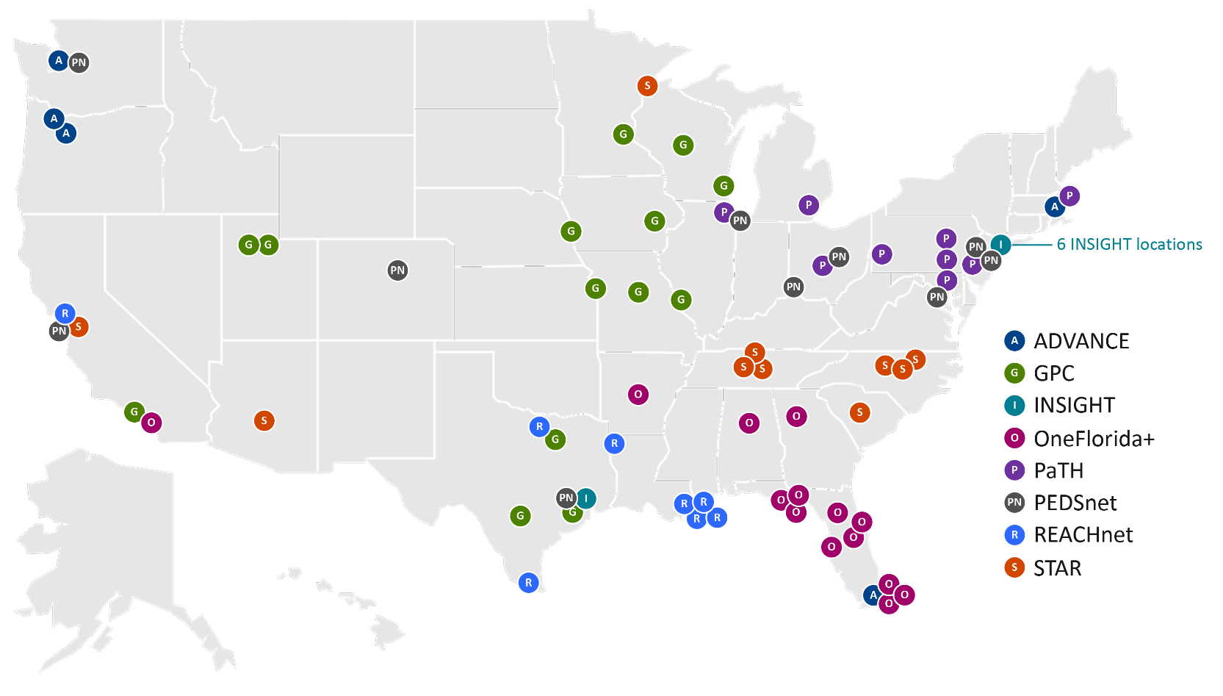
PCORnet® Clinical Research Network locations
PCORnet infrastructure offers access to real-world data through partnerships with Clinical Research Networks (CRNs)
What are Clinical Research Networks?
CRNs are groups of diverse healthcare institutions across the U.S., from large academic health centers to local community clinics, united by a commitment to speed patient-centered research via PCORnet.
4

Slide 5
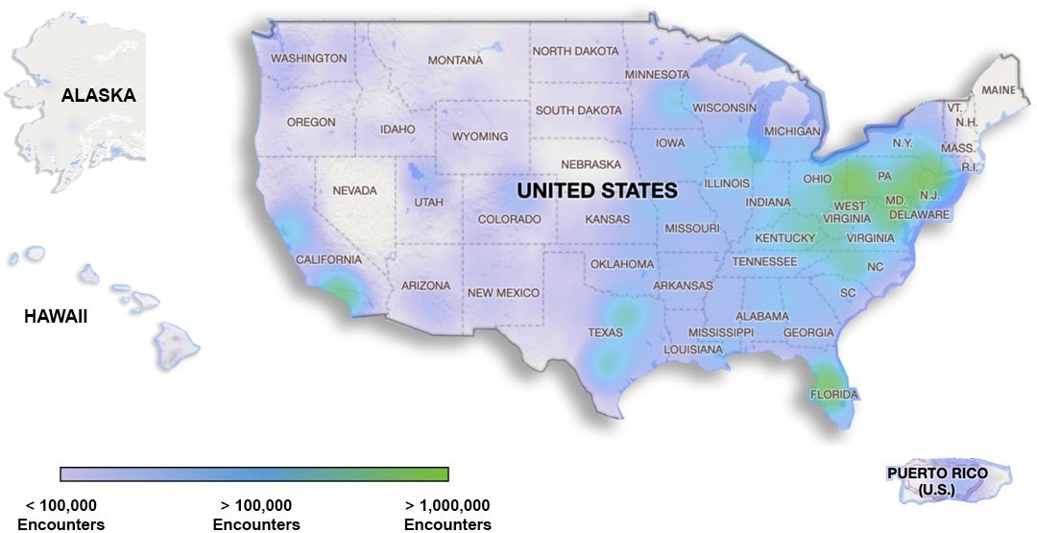
Scope of PCORnet-accessible data
PCORnet represents data from everyday health care encounters with more than 30 million people
across the U.S. each year.
*The data density maps illustrates single addresses that are associated with individual PCORnet Network Partner encounters.
5

Slide 6
The PCORnet® Common Data Model
For data to be useful, it has to be standardized across systems. Frequent data curation and a single language enabled by the PCORnet® Common Data Model delivers fast insights.
Ready for Research
Available, But Still Evolving
Demographics
Diagnoses
Procedures
Immunizations Tumor Registry Biosamples
Vital Signs
Clinical Observations
Social Determinants of Health
Patient-Generated Data
Genomic Results
Labs
Medication Orders & Administrations
Patient- Reported Outcomes
Natural Language Processing Derived Concepts
Data available from Clinical Research Networks, in the PCORnet® Common Data Model and ready for use in research
Data available at some Clinical Research Networks, may or may not be in the PCORnet® Common Data Model and require additional work for use in research
6

Slide 7
Community Engagement via PCORnet®

Slide 8
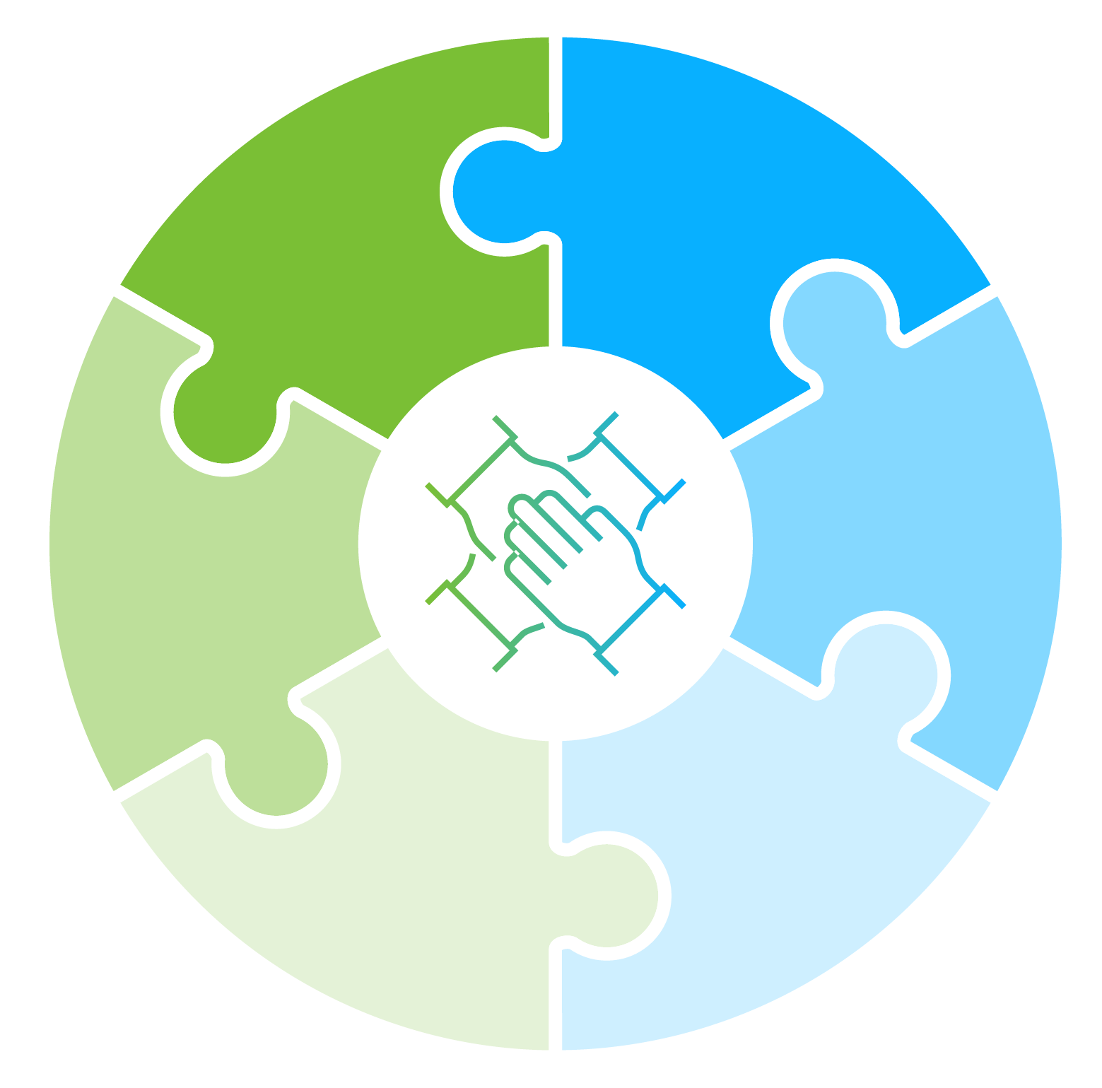
Engaged communities drive better, faster research
Support with patient recruitment
Context of lived
experience
What do we mean by “communities”?
Patients and caregivers,
who have a seat at the table of every PCORnet® Study, engaging as coequal collaborators with health professionals
Clinicians/Clinic Staff
Insurers
Policymakers
Others
Feedback to lessen study burden on participants
Advice for meaningful endpoints
Best tactics to disseminate
research
findings
“Good studies consider all relevant evidence − and no evidence is more relevant
than the community experience.”
– PCORnet Steering Committee Member
Insights to help reach populations
of interest

Slide 9
PCORnet® Compared with Other Research Networks
PCORnet infrastructure brings a full spectrum of capabilities, plus connection to communities
PCORnet | Feasibility queries | Identify patient populations for trial recruitment | Coordinated data curation | Connection to patients and providers
ENACT
TriNetX
OPTUM
OHDSI
Sentinel
= capabilities
= limited capabilities
= lacks capability
9

Slide 10
Work with the Network

Slide 11
The PCORnet® Front Door
The Front Door is the Access Point for PCORnet Resources & Services
A “knock” on the Front Door can also support: Study Design
Preliminary data for proposals, effect sizes
and potential study power
Connections to Network Collaborators
Partners to co-design research
People with specific expertise
PCORnet Study Designation Support
Deeper partnership with PCORnet provides access to best practice sharing, patient engagement, and transparent quality improvement initiatives
Learn More About the Front Door

Slide 12
A secure infrastructure makes real-world data accessible
Step 1
The Requestor
submits a question through the PCORnet® Front Door
Step 2
The Coordinating Center
reviews the question and consults with the Requestor about
next steps
Step 3
The Coordinating
Center converts the request into a query and sends it to Network Partners via a secure portal in the Cloud
Step 4
Network Partners
provide a response, which is sent back through the Coordinating Center to the Requestor
Requestor queries are sent to the data —
and answers, not data, are sent back to requestors.
Read the PCORnet® Privacy Statement

Slide 13
Use Cases

Slide 14
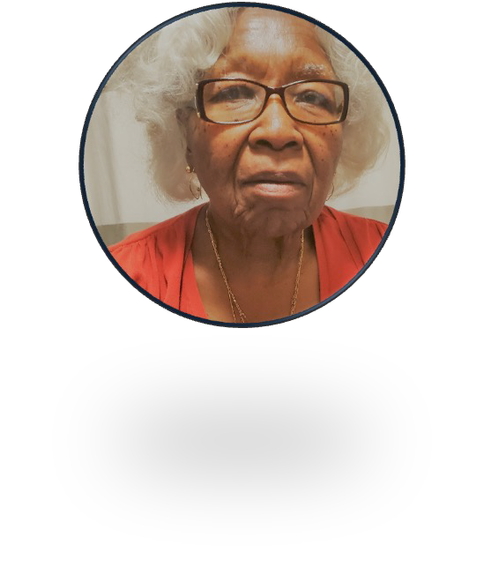
PREVENTABLE
Pragmatic Evaluation of Events and Benefits of Lipid- Lowering in Older Adults
The Question
Can taking a commonly used heart medication prevent dementia in adults over the age of 75?
Study Snapshot
Pragmatic trial
20,000 patients aged 75 and older
100 U.S. sites partnered with PCORnet & the National Veterans Affairs Network
Pragmatic design used existing EHR/Medicare data plus phone surveys. Medications shipped directly to patients
Strength of PCORnet®
A “one stop shop” for capturing 3 complementary sources of data (Medicare, EHR, & survey)
“ I appreciate that PREVENTABLE is looking at a commonly prescribed drug to see if it could benefit seniors.”
Minnie Jefferson, Patient Advisor

Slide 15
PREVENTABLE
Pragmatic Evaluation of Events and Benefits of Lipid- Lowering in Older Adults
IMPACT
Embedded expertise in PCORnet fueled
rapid enrollment of the largest trial in people aged 75+ to date. Broad dissemination via New York Times article, AARP publications, & local senior guides
Because of the pragmatic trial design, only one amendment was needed to the study protocol to respond to COVID-19
Takeaway
PCORnet can effectively support pragmatic studies in challenging populations where participation is a barrier.

Slide 16
ADAPTABLE
Aspirin Dosing: A Patient-centric Trial Assessing Benefits and Long-Term Effectiveness
The Questions
Study Snapshot
Pragmatic clinical trial
15,000 patients living with heart disease
Randomly assigned (1:1 ratio)
Aspirin Dose- 81 mg/day vs. 325 mg/day
Which aspirin dose offers the right balance of effectiveness and minimal risk of bleeding?
Can PCORnet be used to find the answer using a clinical trial model wherein patients are drivers of engagement?
Strength of PCORnet®
Adaptors: Nine patient partners from ADAPTABLE’s clinical research networks.
Offered study guidance
Embedded at every study step, from study concept to completion and dissemination
“I have lost three friends to heart disease; I don’t want to lose more.” Ken Gregorie, Adaptor

Slide 17
ADAPTABLE
Aspirin Dosing: A Patient-centric Trial Assessing Benefits and Long-Term Effectiveness
IMPACT
ADAPTORS CONTRIBUTED TO 3 KEY EFFORTS:
Newsletter for Enrolled Patients:
Quarterly, included study updates plus patients’ personal stories
493 participants have shared their personal story to date
Study Communication:
Revised study materials
to make them more understandable for a patient audience and coached the study team at limited sites
in mock calls to potential participants
Clinician Engagement:
Adaptors educated clinicians on what aspects of ADAPTABLE were engaging to them to improve participation rates
Over 15,000 patients enrolled from 40 sites over 38 months Results published May 2021, New England Journal of Medicine
Takeaway
PCORnet infrastructure supports patient partner engagement that can fortify your study’s efforts and contribute to faster enrollment and improved retention.

Slide 18
BP Control Laboratory
A Reusable Platform for Efficient Surveillance and Comparative Effectiveness Research
The Question
Can PCORnet support a reusable platform to reduce patient/investigator burden and streamline evidence generation around new programs or technologies designed to help improve blood pressure control?
Study Snapshot
Platform supported three demonstration studies:
BP Track, a national surveillance project
BP MAP, a cluster randomized controlled trial
BP Home, an individual level randomized controlled trial
Strength of PCORnet®
Broad reach into a large percentage of the U.S. population
Established connections across major health systems
Shared Common Data Model to standardize disparate electronic health record (EHR) data codes

Slide 19
BP Control Laboratory
A Reusable Platform for Efficient Surveillance and Comparative Effectiveness Research
Pragmatic design allowed for direct patient engagement and collection of patient-generated health data (Eureka)
Assessed EHR data from 25 participating health systems via PCORnet
Development of the novel platform was featured in Circulation: Cardiovascular and Quality Outcomes
Results from BP Track featured in the
Journal of American Heart Association
Results from BP Home featured in JAMA Internal Medicine
Takeaway
PCORnet can be used to accelerate evidence generation and translation of innovative healthcare delivery solutions into major
population health benefits.

Slide 20
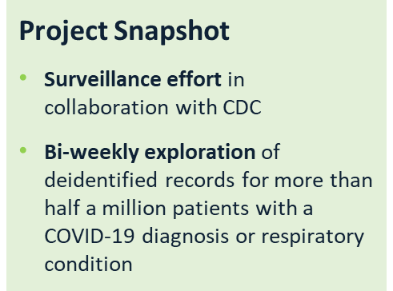
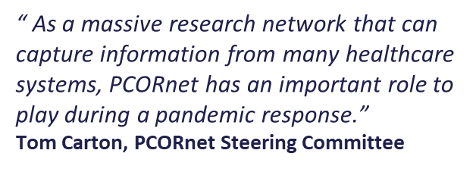
CDC COVID-19 Collaboration
Shaping the national understanding of COVID-19
The Question
Can the PCORnet infrastructure be used for real-time reporting and surveillance of COVID-19 patterns across the country?
Strength of PCORnet®
Partnership with diverse health systems that hold electronic records for health encounters for more than 30 million people across the U.S. each year

Slide 21
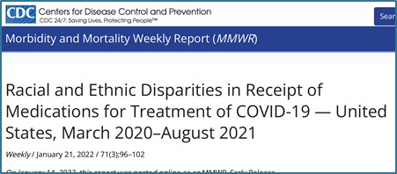
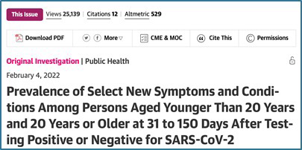
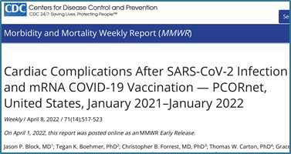
CDC COVID-19 Collaboration
Shaping the national understanding of COVID-19
IMPACT
Answered crucial questions relevant to public health via numerous journal publications
Racial and ethnic disparities in the use of
monoclonal antibodies
Understanding "long COVID"
Myocarditis and pericarditis rates after COVID-19 vaccination
Takeaway
PCORnet can effectively support national surveillance studies with near-real-time reporting to unlock valuable insights in times of crisis when answers can't wait.

Slide 22
PCORnet® Resources
Materials developed using the Network are shared to promote lessons learned and best practices via the Resources page on PCORnet.org.
Resources are sorted by Research, Data, and Engagement and searchable by keyword. They include engagement case studies, lay audience glossaries, the PCORnet® Common Data Model, and more.

Slide 23
Learn More
Work with the Network Visit www.pcornet.org to get started!
PCORnet® has been developed with funding from the Patient-Centered Outcomes Research Institute® (PCORI®)
21

Slide 24
Appendix

Slide 25
How is data linked while being kept secure?
Common Data Linkage
Through strategic collaboration,
PCORnet® Network Partners worked to establish a secure and standardized privacy-preserving record linkage (PPRL) infrastructure that is reusable and scalable
Each PCORnet network site uses software
that converts data into de-identified tokens that can be securely shared with the Coordinating Center for PCORnet
The tokens are included in a table that is associated with each site’s Common Data Model
From there, the Coordinating Center uses a matching software to determine whether a patient’s data exists at more than one site (duplicative data)

Slide 26
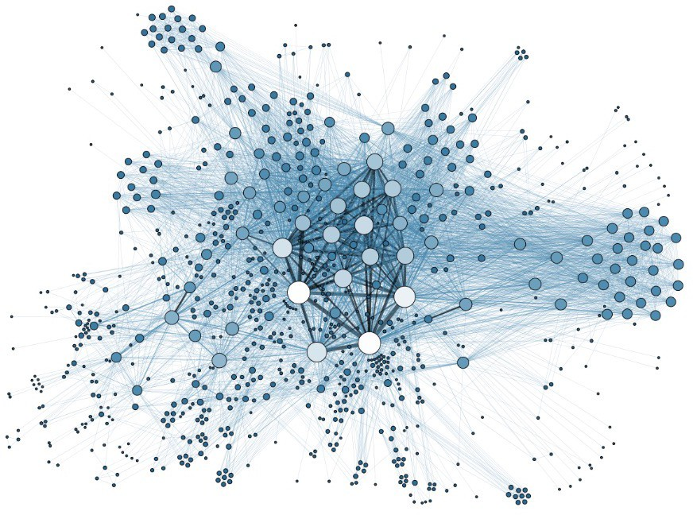
What types of data have PCORnet® Network Partners linked using PPRL ?
Claims data
Data included in health registries
Data that has been duplicated across healthcare systems

Slide 27
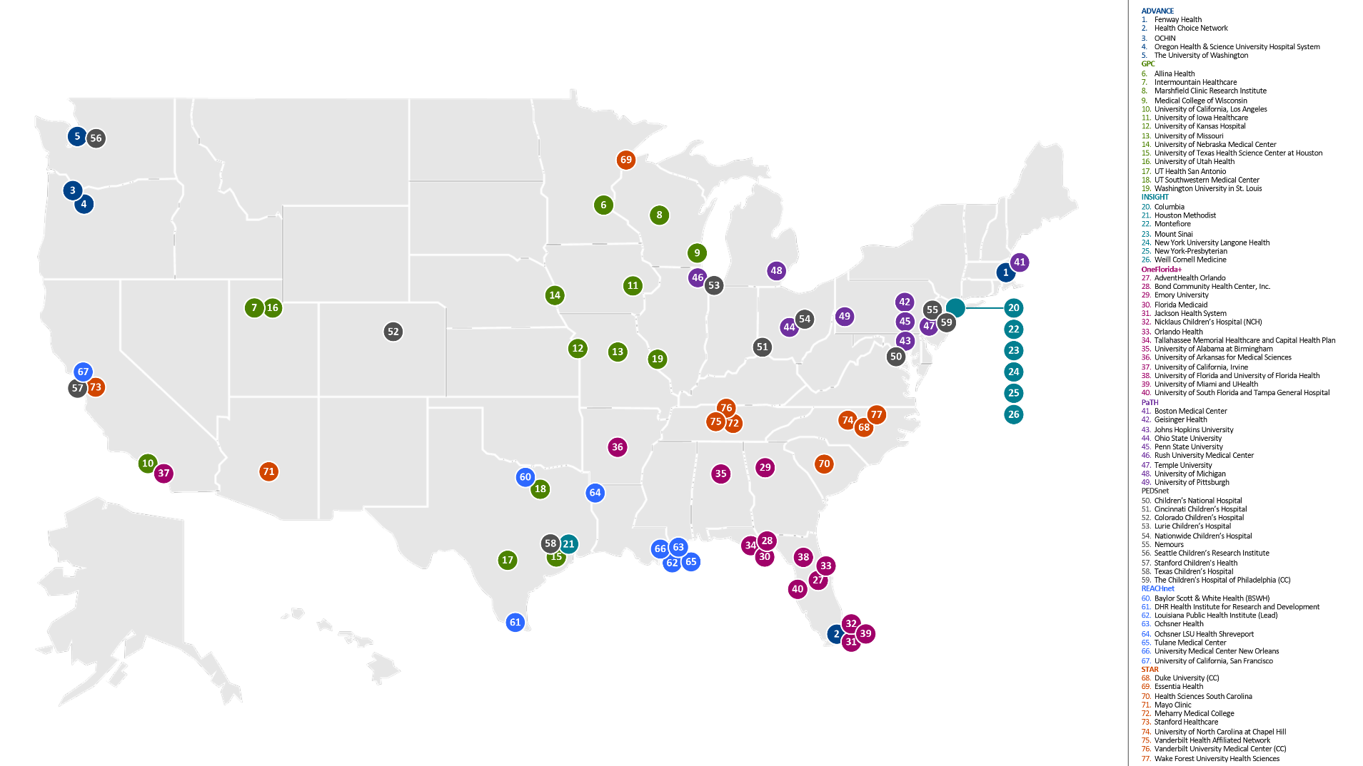
PCORnet® Clinical Research Network Locations
4

Slide 28
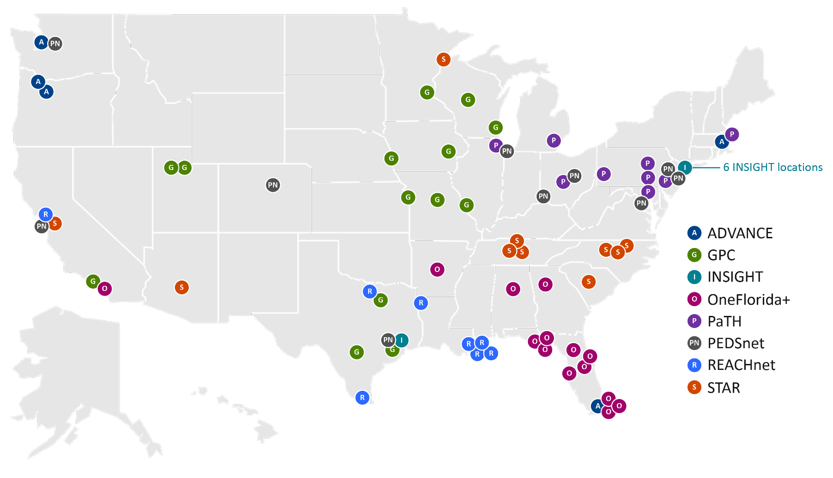
PCORnet® Clinical Research Network Locations
4

Slide 29
PCORnet® Clinical Research Network Locations
ADVANCE
Fenway Health
Health Choice Network
OCHIN
Oregon Health & Science University Hospital System
The University of Washington
GPC
Allina Health
Intermountain Healthcare
Marshfield Clinic Research Institute
Medical College of Wisconsin
University of California, Los Angeles
University of Iowa Healthcare
University of Kansas Hospital
University of Missouri
University of Nebraska Medical Center
University of Texas Health Science Center at Houston
University of Utah Health
UT Health San Antonio
UT Southwestern Medical Center
Washington University in St. Louis
INSIGHT
Columbia
Houston Methodist
Montefiore
Mount Sinai
New York University Langone Health
New York-Presbyterian
Weill Cornell Medicine
OneFlorida+
AdventHealth Orlando
Bond Community Health Center, Inc.
Emory University
Florida Medicaid
Jackson Health System
Nicklaus Children’s Hospital (NCH)
Orlando Health
Tallahassee Memorial Healthcare and Capital Health Plan
University of Alabama at Birmingham
University of Arkansas for Medical Sciences
University of California, Irvine
University of Florida and University of Florida Health
University of Miami and UHealth
University of South Florida and Tampa General Hospital
PaTH
Boston Medical Center
Geisinger Health
Johns Hopkins University
Ohio State University
Penn State University
Rush University Medical Center
Temple University
University of Michigan
University of Pittsburgh
PEDSnet
Children’s National Hospital
Cincinnati Children’s Hospital
Colorado Children’s Hospital
Lurie Children’s Hospital
Nationwide Children’s Hospital
Nemours
Seattle Children’s Research Institute
Stanford Children's Health
Texas Children’s Hospital
The Children’s Hospital of Philadelphia (CC)
REACHnet
Baylor Scott & White Health (BSWH)
DHR Health Institute for Research and Development
Louisiana Public Health Institute (Lead)
Ochsner Health
Ochsner LSU Health Shreveport
Tulane Medical Center
University Medical Center New Orleans
University of California, San Francisco
STAR
Duke University (CC)
Essentia Health
Health Sciences South Carolina
Mayo Clinic
Meharry Medical College
Stanford Healthcare
University of North Carolina at Chapel Hill
Vanderbilt Health Affiliated Network
Vanderbilt University Medical Center (CC)
Wake Forest University Health Sciences
4

